Slide 1


Counselor: THE School Management Platform
Introducing a comprehensive, AI-powered platform designed to simplify school administration, improve student and teacher engagement, and enhance operational efficiency.
Made By: Fares Abdi (Full-stack dev) Raouf Zobir (back-end expert ) Anas Alasmer( front-end expert) Ziad Bentmati (ai expert)
Notes:
1

Slide 2



The Need for Streamlined School Management
Inefficient Processes
Lack of Real-Time Insights
Communication Challenges
Manual processes for tasks like attendance, scheduling, and communication lead to time-consuming efforts and errors.
Disjointed communication between students, teachers, and administrators create confusion and delays.
Limited access to data and insights hampers informed decision-making and proactive problem-solving.
Notes:
2

Slide 3


Student and Teacher Management
Student Profiles
Teacher Management
Comprehensive student profiles with academic records, attendance data, and personalized information.
Streamlined teacher management, including assigning classes, tracking progress, and facilitating communication.
Notes:
4

Slide 4
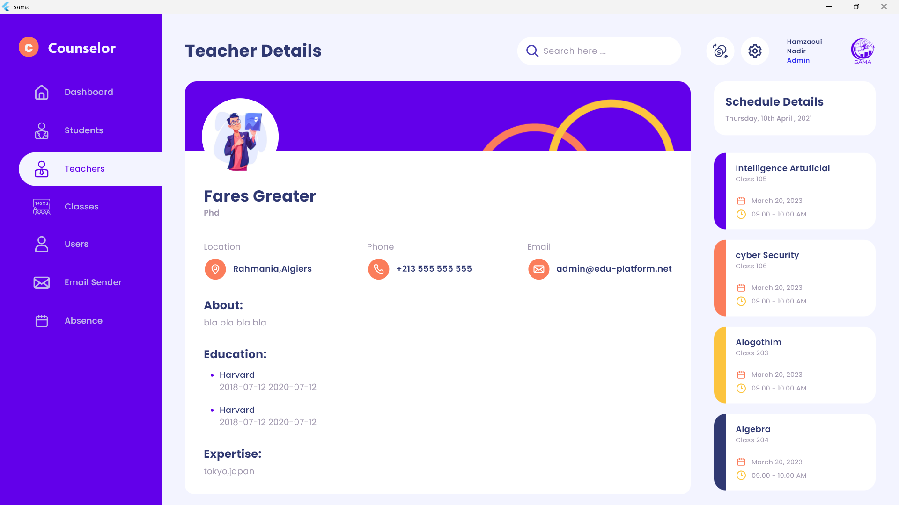




Our Solution: A Comprehensive Platform
Streamlined Operations
1
Centralized platform to manage all aspects of school administration, including attendance, scheduling, communication, and finances.
2
Real-Time Insights
Data-driven insights for informed decision-making and proactive problem-solving.
3
Enhanced Communication
Improved communication channels for students, teachers, and administrators.
AI-Powered Efficiency
4
AI-powered features for automating tasks, enhancing accuracy, and boosting productivity.
Student and Teacher Management
Notes:
3

Slide 5
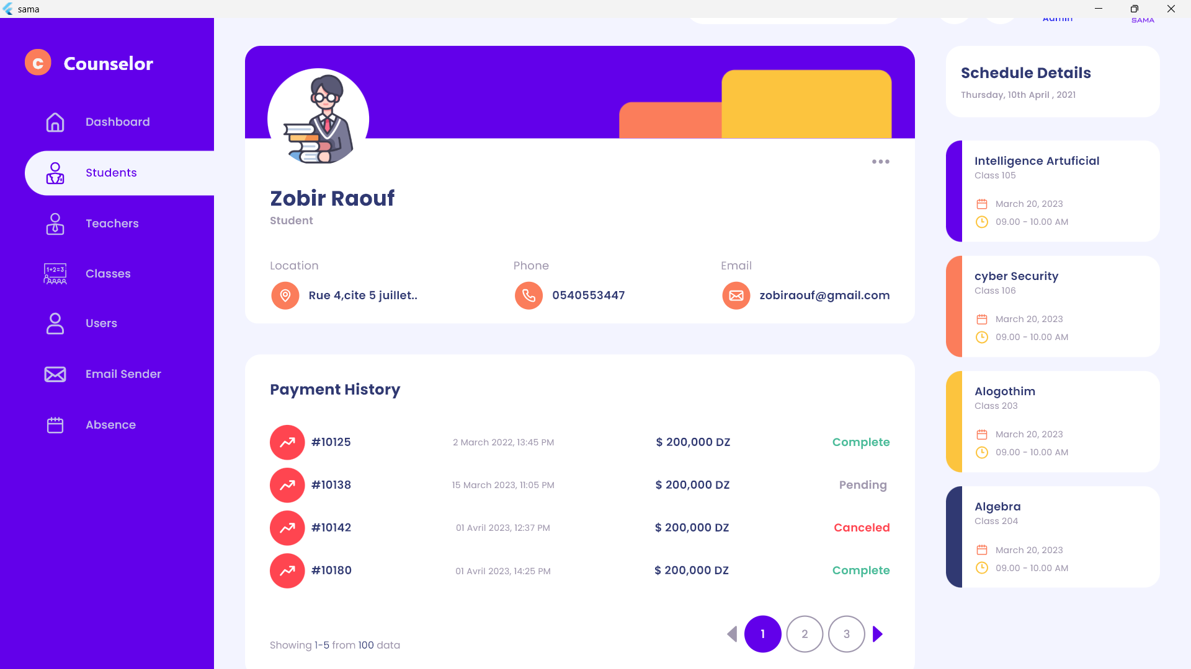
Our Solution: A Comprehensive Platform
Streamlined Operations
1
Centralized platform to manage all aspects of school administration, including attendance, scheduling, communication, and finances.
2
Real-Time Insights
Data-driven insights for informed decision-making and proactive problem-solving.
3
Enhanced Communication
Improved communication channels for students, teachers, and administrators.
AI-Powered Efficiency
4
AI-powered features for automating tasks, enhancing accuracy, and boosting productivity.
Student and Teacher Management
Notes:
3

Slide 6
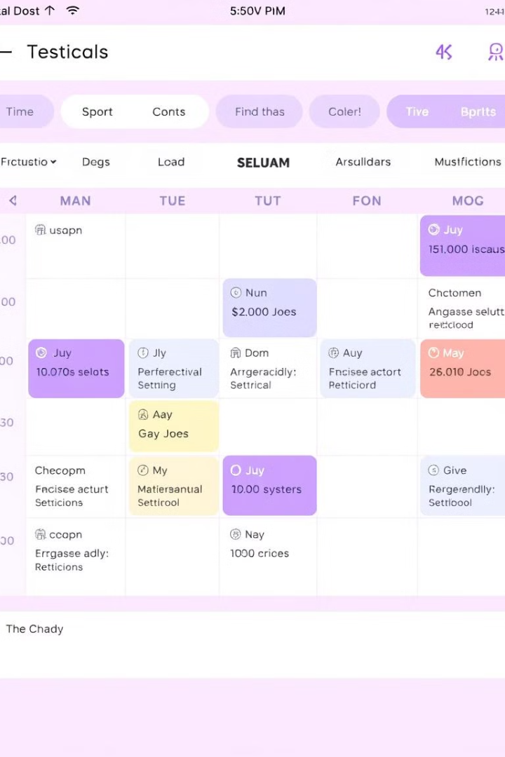
Calendar Scheduling and Coordination
1
Class Schedules
Easy-to-use calendar for scheduling classes, assignments, and exams.
2
Event Coordination
Centralized platform for managing school events, including parent-teacher meetings, extracurricular activities, and field trips.
3
Real-Time Updates
Notifications for changes in schedules, reminders for assignments, and important announcements.
Notes:
5

Slide 7
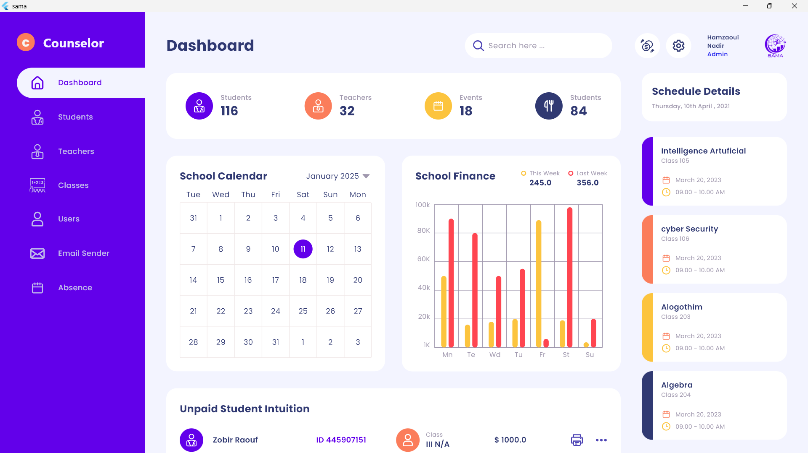
Our Solution: A Comprehensive Platform
Streamlined Operations
1
Centralized platform to manage all aspects of school administration, including attendance, scheduling, communication, and finances.
2
Real-Time Insights
Data-driven insights for informed decision-making and proactive problem-solving.
3
Enhanced Communication
Improved communication channels for students, teachers, and administrators.
AI-Powered Efficiency
4
AI-powered features for automating tasks, enhancing accuracy, and boosting productivity.
Calendar Scheduling and Coordination
Notes:
3

Slide 8

Automated Payment Processing
Tuition Payments
Fee Management
Transparent Reporting
Automated system for processing tuition payments, including installments and financial aid.
Efficiently track and manage other fees, such as book fees, lab fees, and extracurricular fees.
Detailed payment history and reports for students, parents, and administrators.
Notes:
6

Slide 9
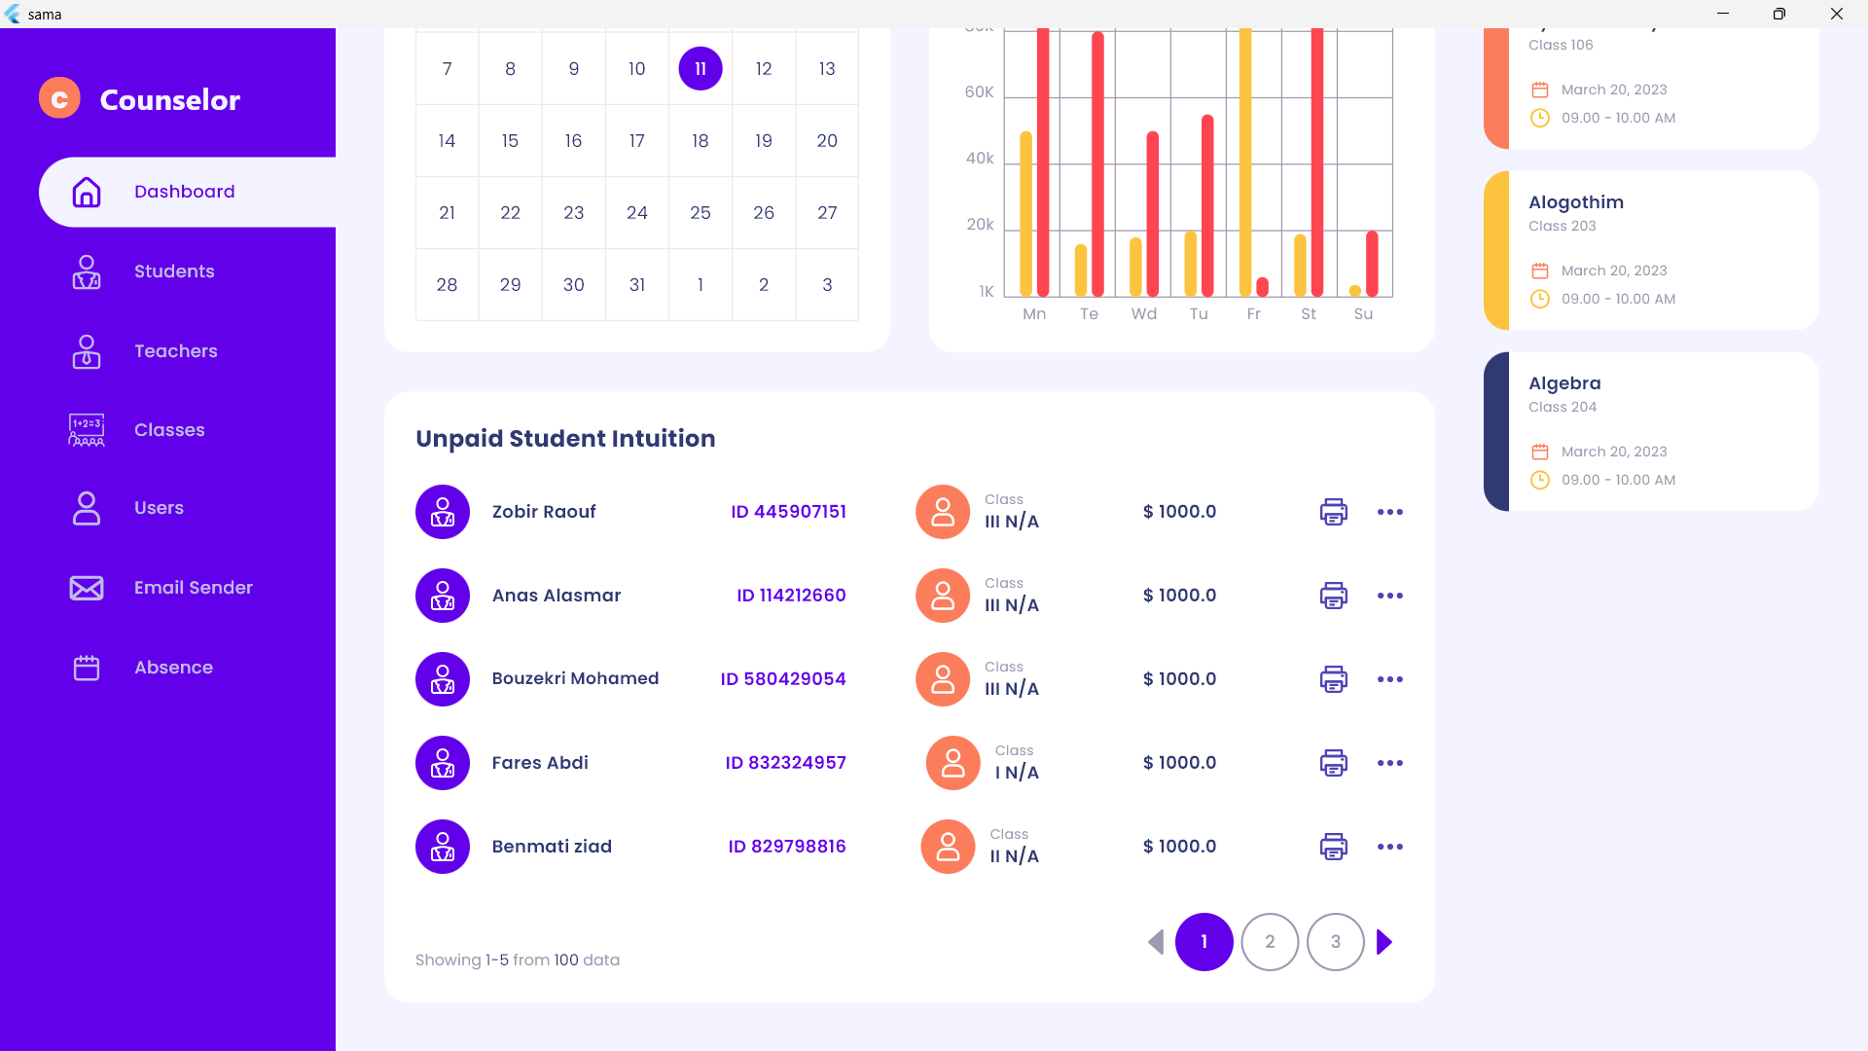
Our Solution: A Comprehensive Platform
Streamlined Operations
1
Centralized platform to manage all aspects of school administration, including attendance, scheduling, communication, and finances.
2
Real-Time Insights
Data-driven insights for informed decision-making and proactive problem-solving.
3
Enhanced Communication
Improved communication channels for students, teachers, and administrators.
AI-Powered Efficiency
4
AI-powered features for automating tasks, enhancing accuracy, and boosting productivity.
Automated Payment Processing
Notes:
3

Slide 10




AI-Powered Attendance Tracking
Facial Recognition
OCR Technology
AI-powered face recognition system for accurate and efficient attendance tracking.
Optical character recognition (OCR) for automated attendance recording from physical forms.
Data Analysis
Real-time insights into attendance patterns, identifying potential issues and trends.
Notes:
7

Slide 11
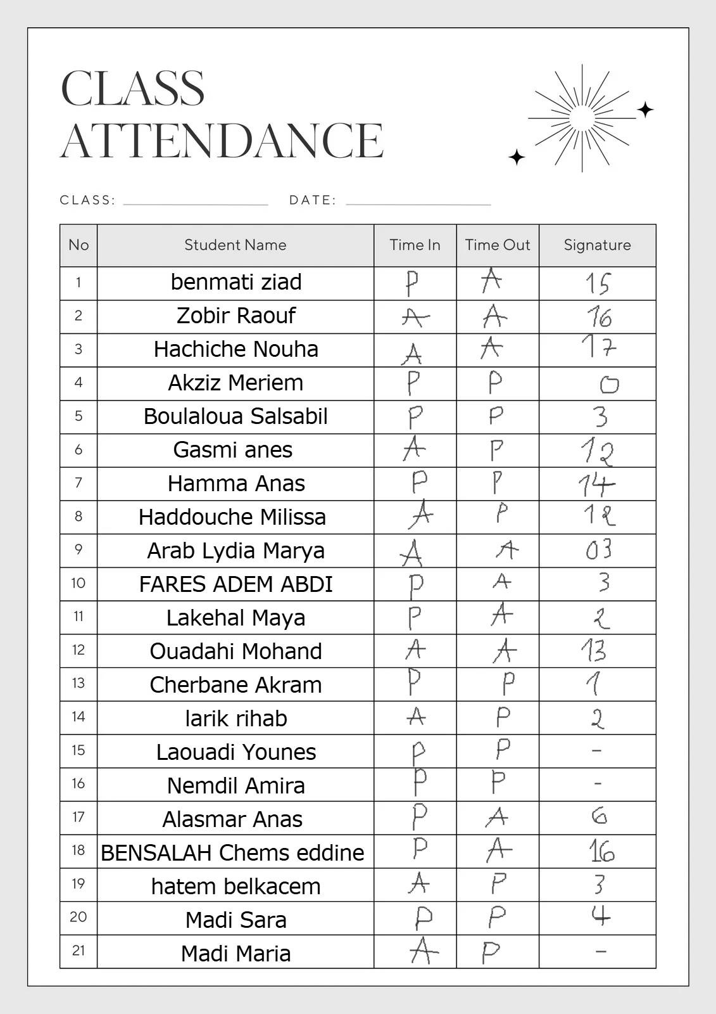
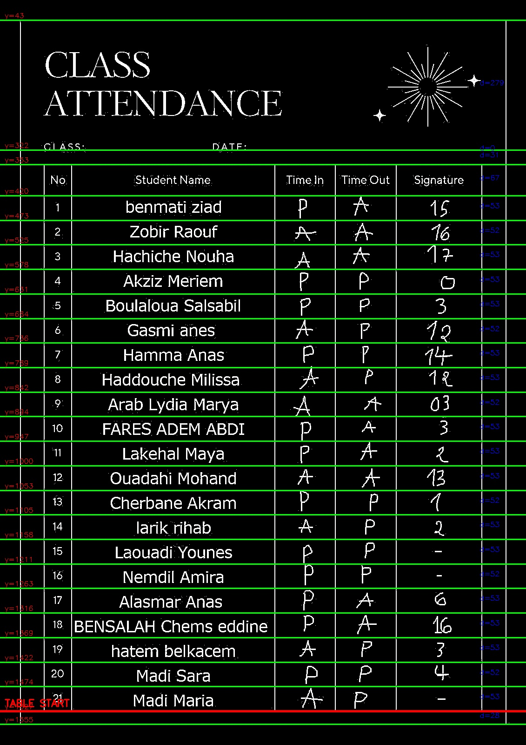


Data Base
Scanned Picture
OCR SYSTEM
AI-Powered Attendance Tracking

Slide 12
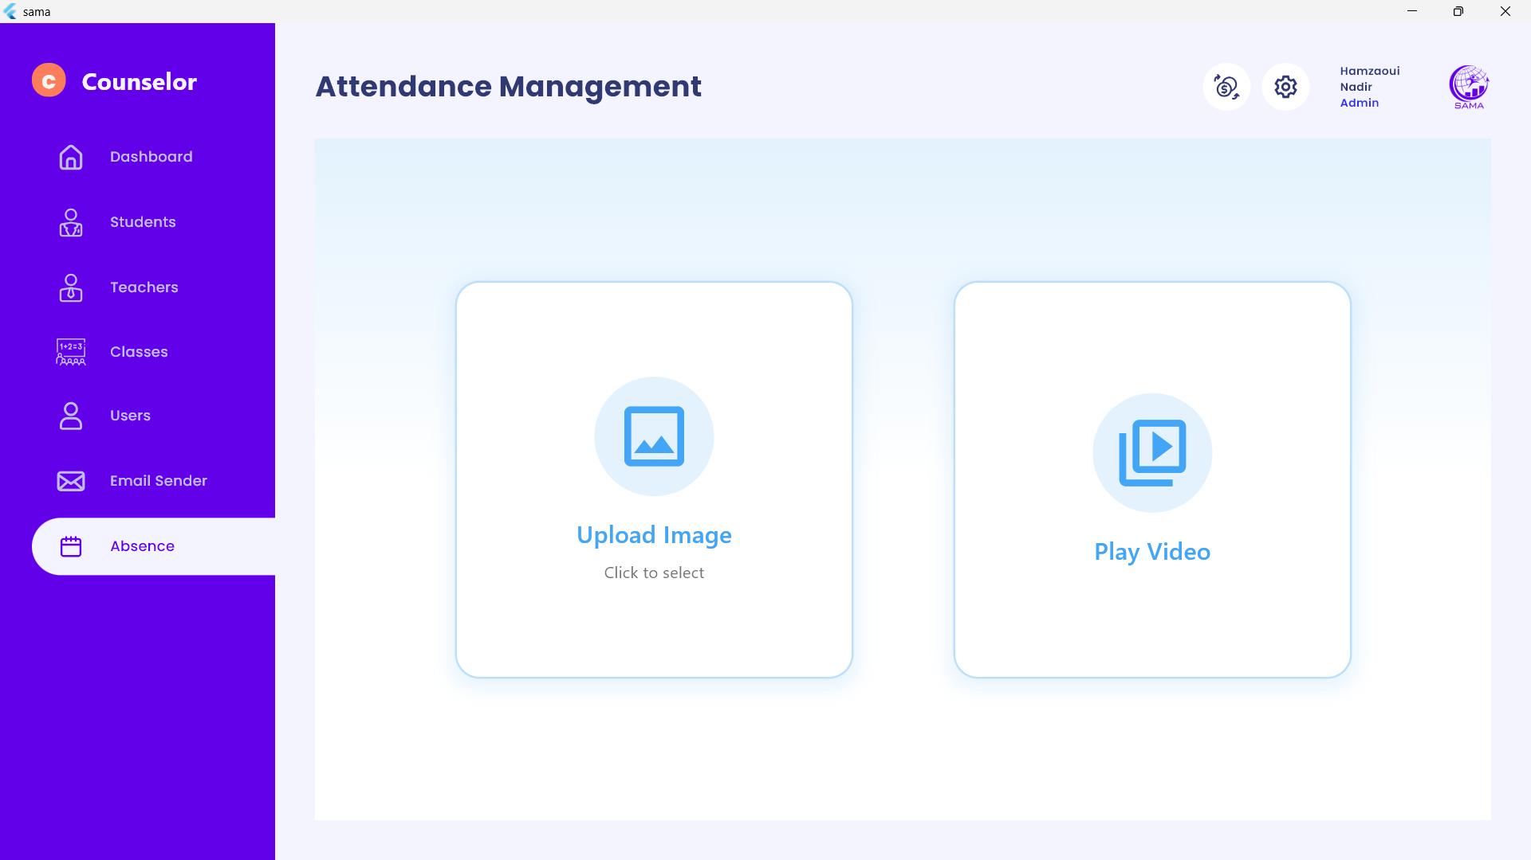
Our Solution: A Comprehensive Platform
Streamlined Operations
1
Centralized platform to manage all aspects of school administration, including attendance, scheduling, communication, and finances.
2
Real-Time Insights
Data-driven insights for informed decision-making and proactive problem-solving.
3
Enhanced Communication
Improved communication channels for students, teachers, and administrators.
AI-Powered Efficiency
4
AI-powered features for automating tasks, enhancing accuracy, and boosting productivity.
AI-Powered Attendance Tracking
Notes:
3

Slide 13
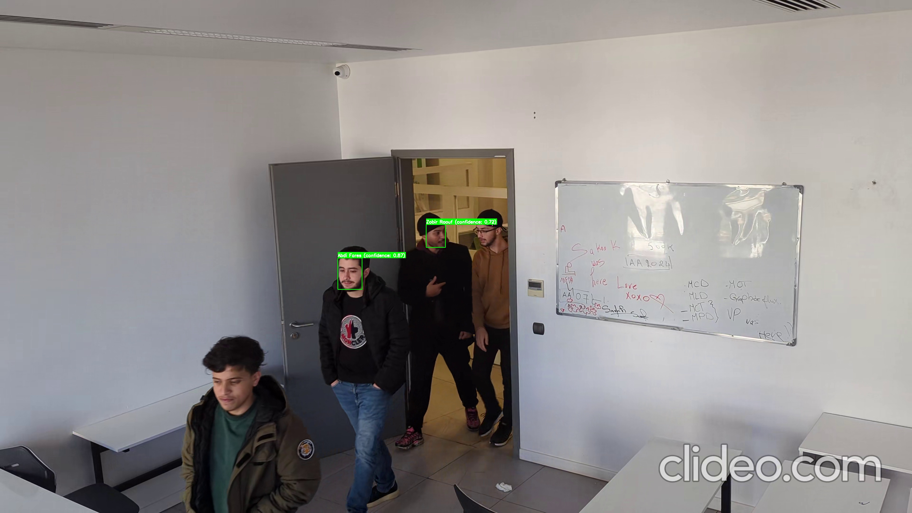
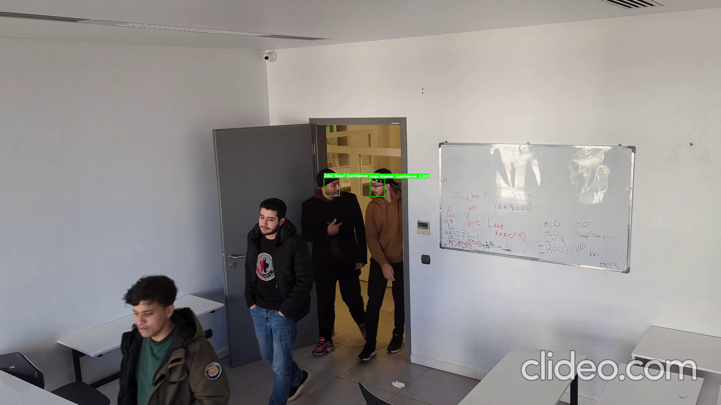
AI-Powered Attendance Tracking

Slide 14




Intelligent Email Assistant: Gemini API Integration
Personalized Emails
AI-powered assistant that generates personalized emails based on user input.
Automated Responses
Automate responses to frequently asked questions, reducing manual workload.
Gemini API Integration
Leverage Gemini's powerful language capabilities for natural language processing and understanding.
Notes:
8

Slide 15
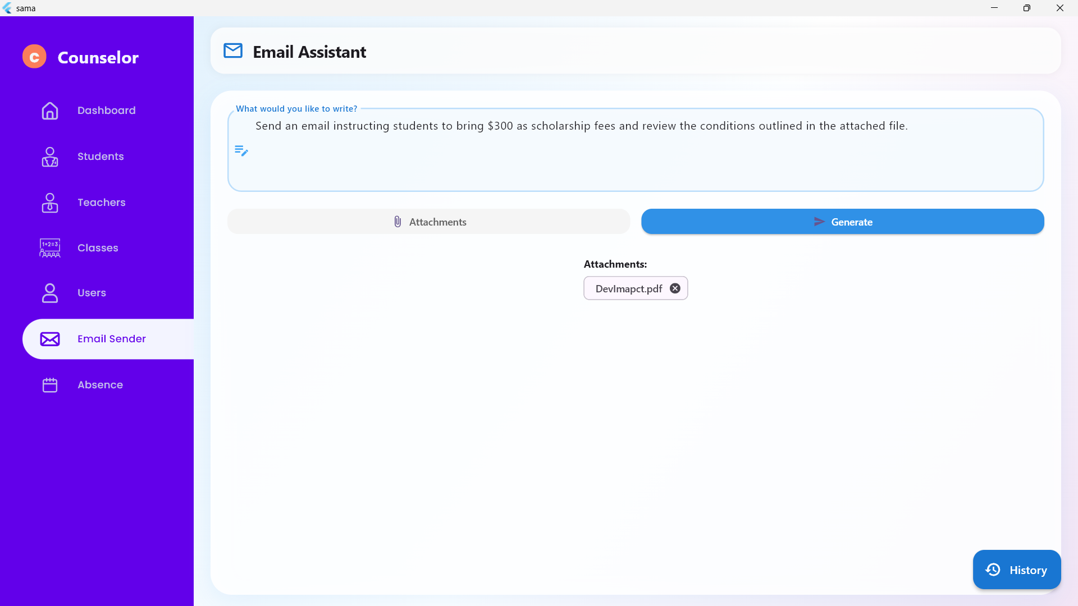
Our Solution: A Comprehensive Platform
Streamlined Operations
1
Centralized platform to manage all aspects of school administration, including attendance, scheduling, communication, and finances.
2
Real-Time Insights
Data-driven insights for informed decision-making and proactive problem-solving.
3
Enhanced Communication
Improved communication channels for students, teachers, and administrators.
AI-Powered Efficiency
4
AI-powered features for automating tasks, enhancing accuracy, and boosting productivity.
Intelligent Email Assistant: Gemini API Integration
Notes:
3

Slide 16
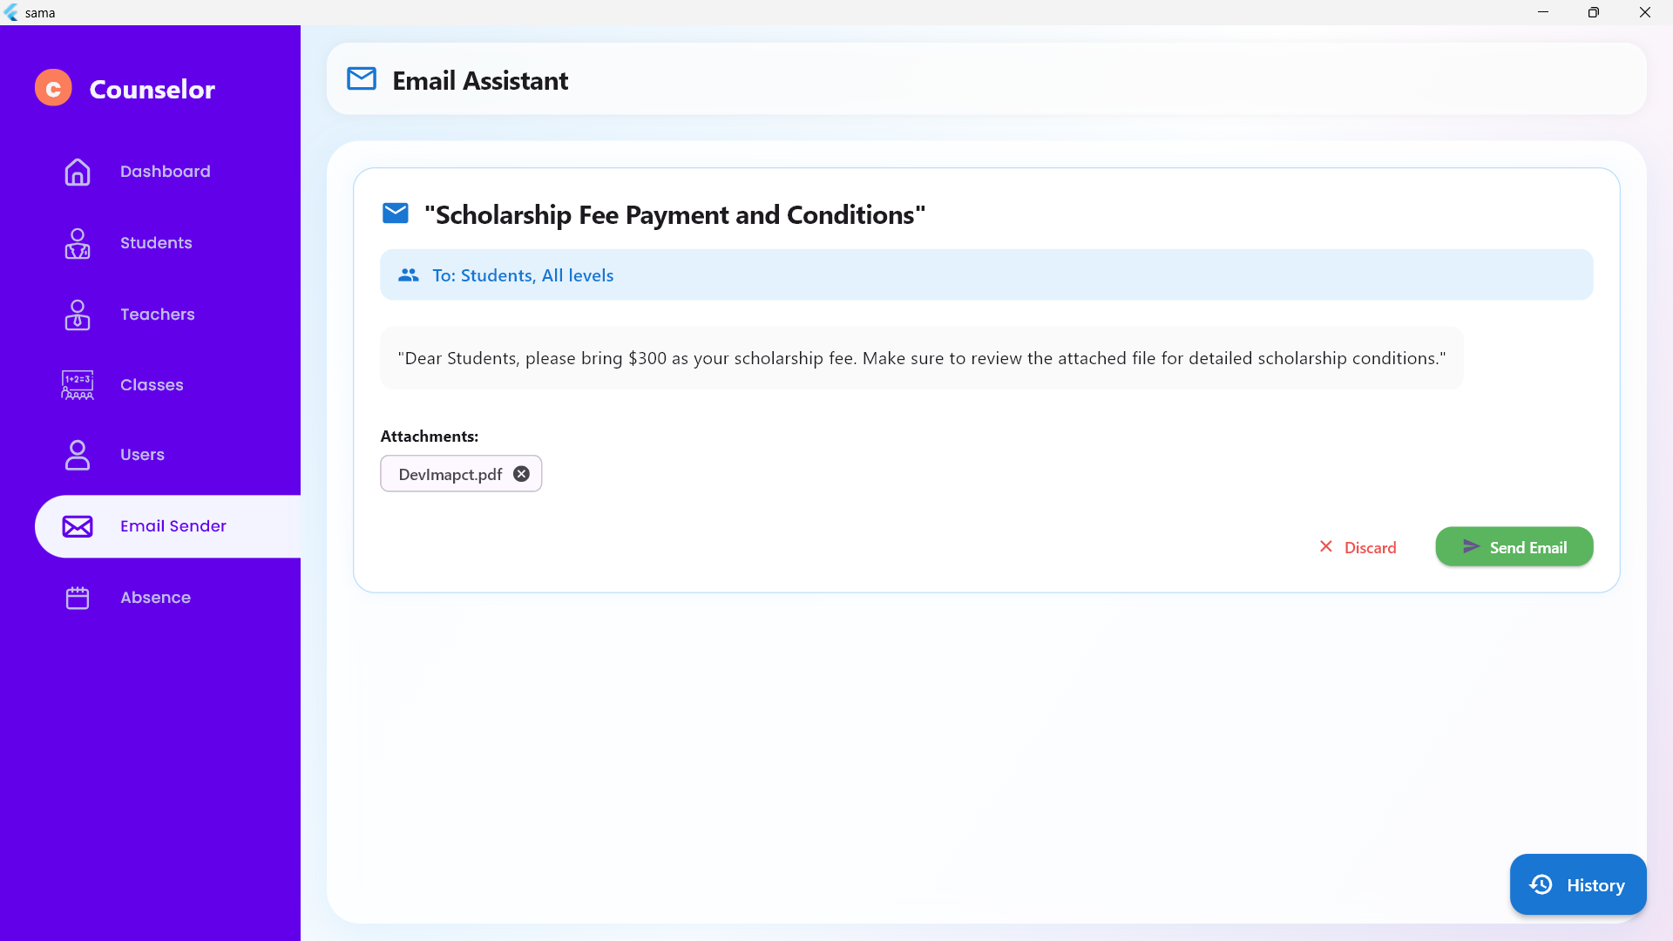
Our Solution: A Comprehensive Platform
Streamlined Operations
1
Centralized platform to manage all aspects of school administration, including attendance, scheduling, communication, and finances.
2
Real-Time Insights
Data-driven insights for informed decision-making and proactive problem-solving.
3
Enhanced Communication
Improved communication channels for students, teachers, and administrators.
AI-Powered Efficiency
4
AI-powered features for automating tasks, enhancing accuracy, and boosting productivity.
Intelligent Email Assistant: Gemini API Integration
Notes:
3

Slide 17
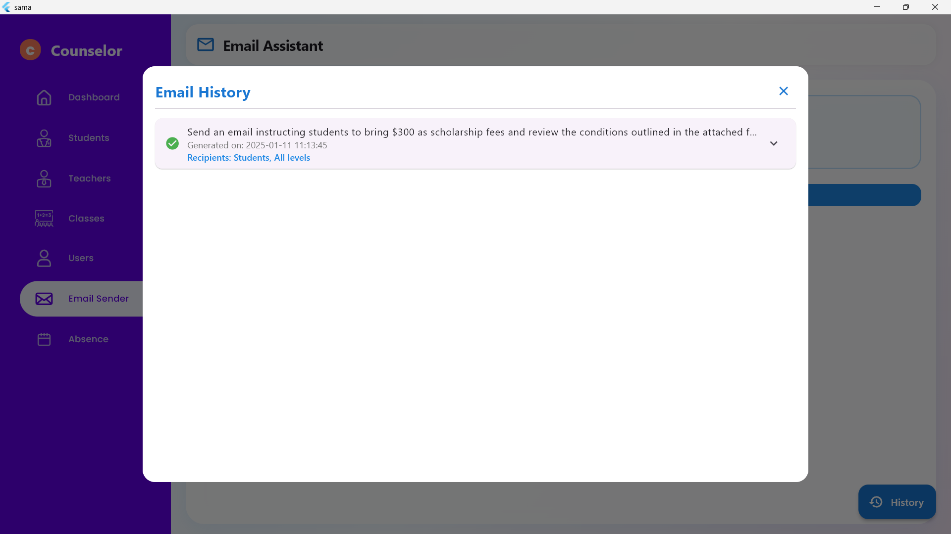
Our Solution: A Comprehensive Platform
Streamlined Operations
1
Centralized platform to manage all aspects of school administration, including attendance, scheduling, communication, and finances.
2
Real-Time Insights
Data-driven insights for informed decision-making and proactive problem-solving.
3
Enhanced Communication
Improved communication channels for students, teachers, and administrators.
AI-Powered Efficiency
4
AI-powered features for automating tasks, enhancing accuracy, and boosting productivity.
Intelligent Email Assistant: Gemini API Integration
Notes:
3

Slide 18




Monetization Opportunities: Licensing Models
Per-Student Licensing
Annual/Monthly Subscription
Custom Packages
Offer an annual subscription model for schools, with access to all features and ongoing support.
Provide per-student licensing, allowing schools to scale the platform based on their needs.
Offer customized packages tailored to specific school requirements and budget constraints.
Notes:
9

Slide 19

Conclusion and Next Steps
The School Management App is poised to revolutionize education by streamlining operations, improving communication, and providing real-time insights. We're excited to partner with schools and educators to implement this innovative platform and unlock its full potential.
Notes:
10

